Slide 1


Optimizing Data Insights: Premier League Anti-Social Behaviour Project

Slide 2


Today's agenda
The Analyst
Project recap
Problem
Process
Insights
Summary

Slide 3

The Analyst
Ferguson Osadolor
Data Analyst

Slide 4


Problem
Collecting data on 50+ types of anti-social behaviour
Tackling;
The collation and quality assurance of input data
The management of the database to generate insightful outputs

Slide 5
Process
1
Introduction
2
Collation and Quality Assurance
3
Database Management
4
Analytics and Reporting
5
Conclusion

Slide 6

Introduction
Anti-social behaviour

Slide 7
Collation and Quality Assurance
Observer training
Understanding anti-social behavior
Data collection tools and techniques

Slide 8
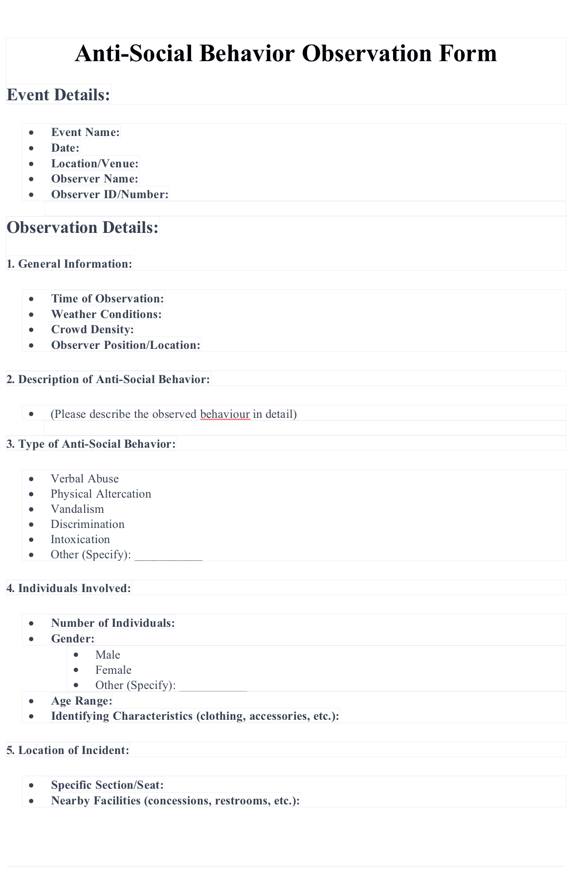
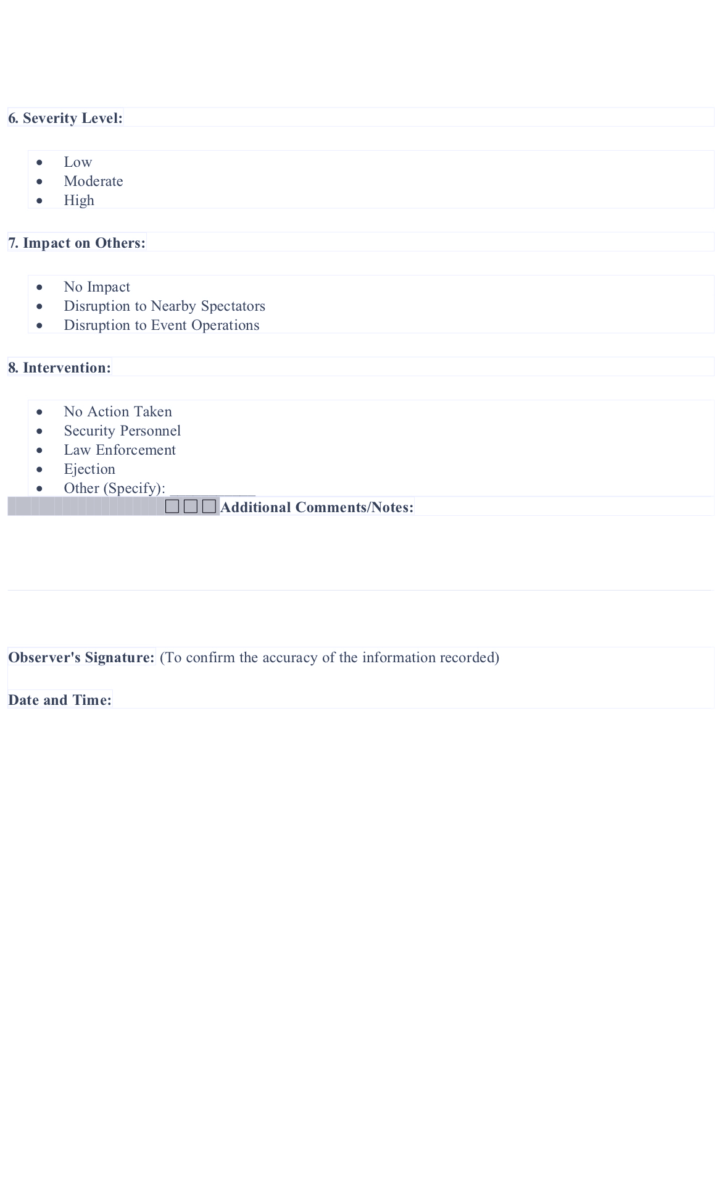
Collation and Quality Assurance

Slide 9
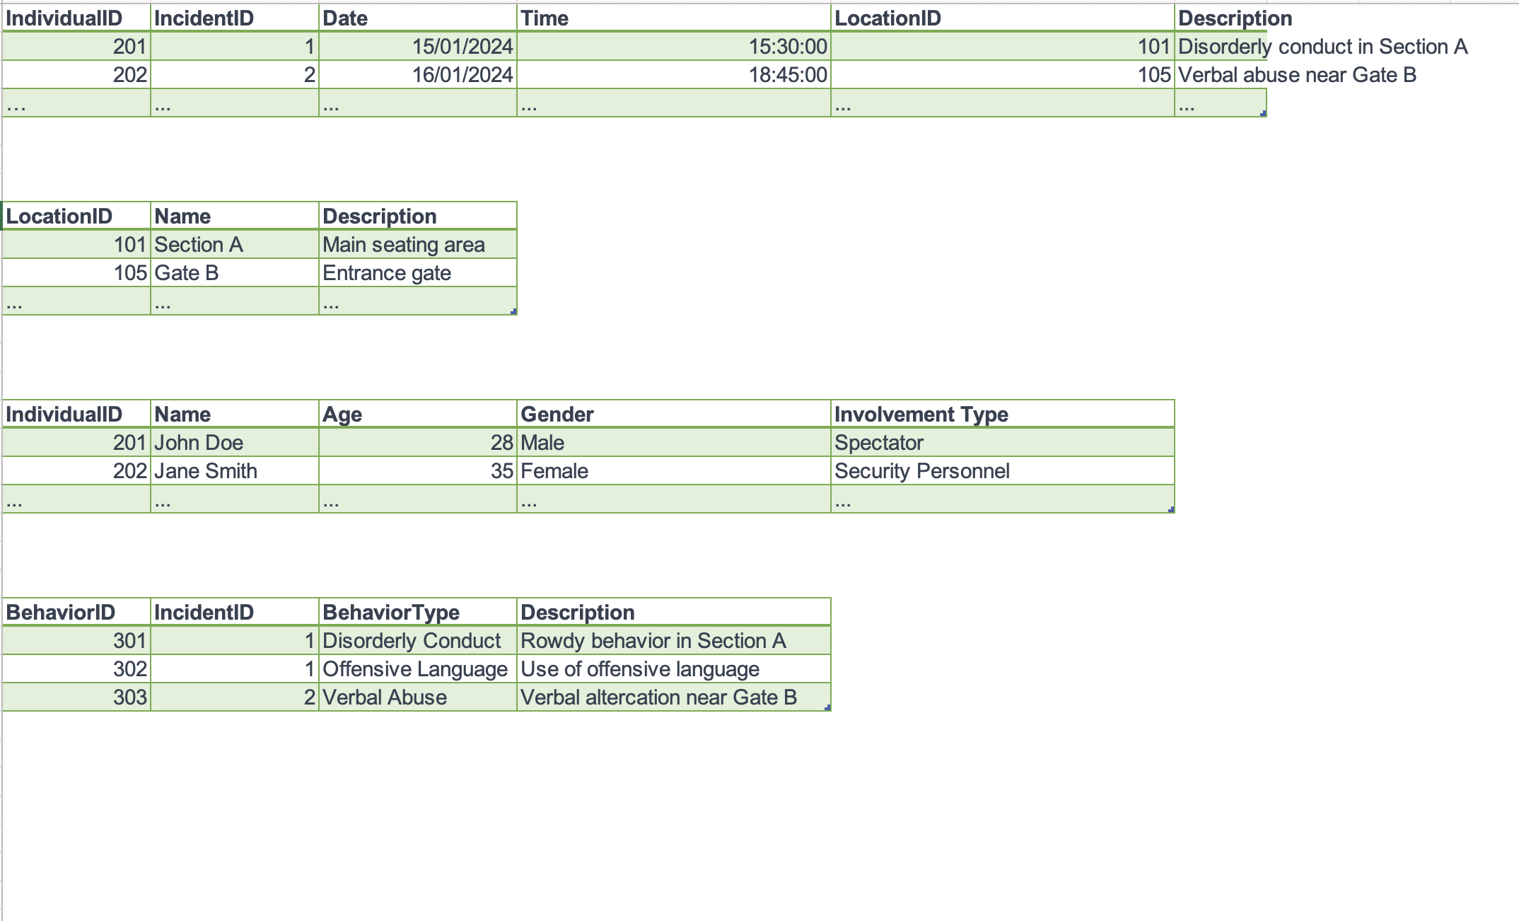
Database architecture

Slide 10
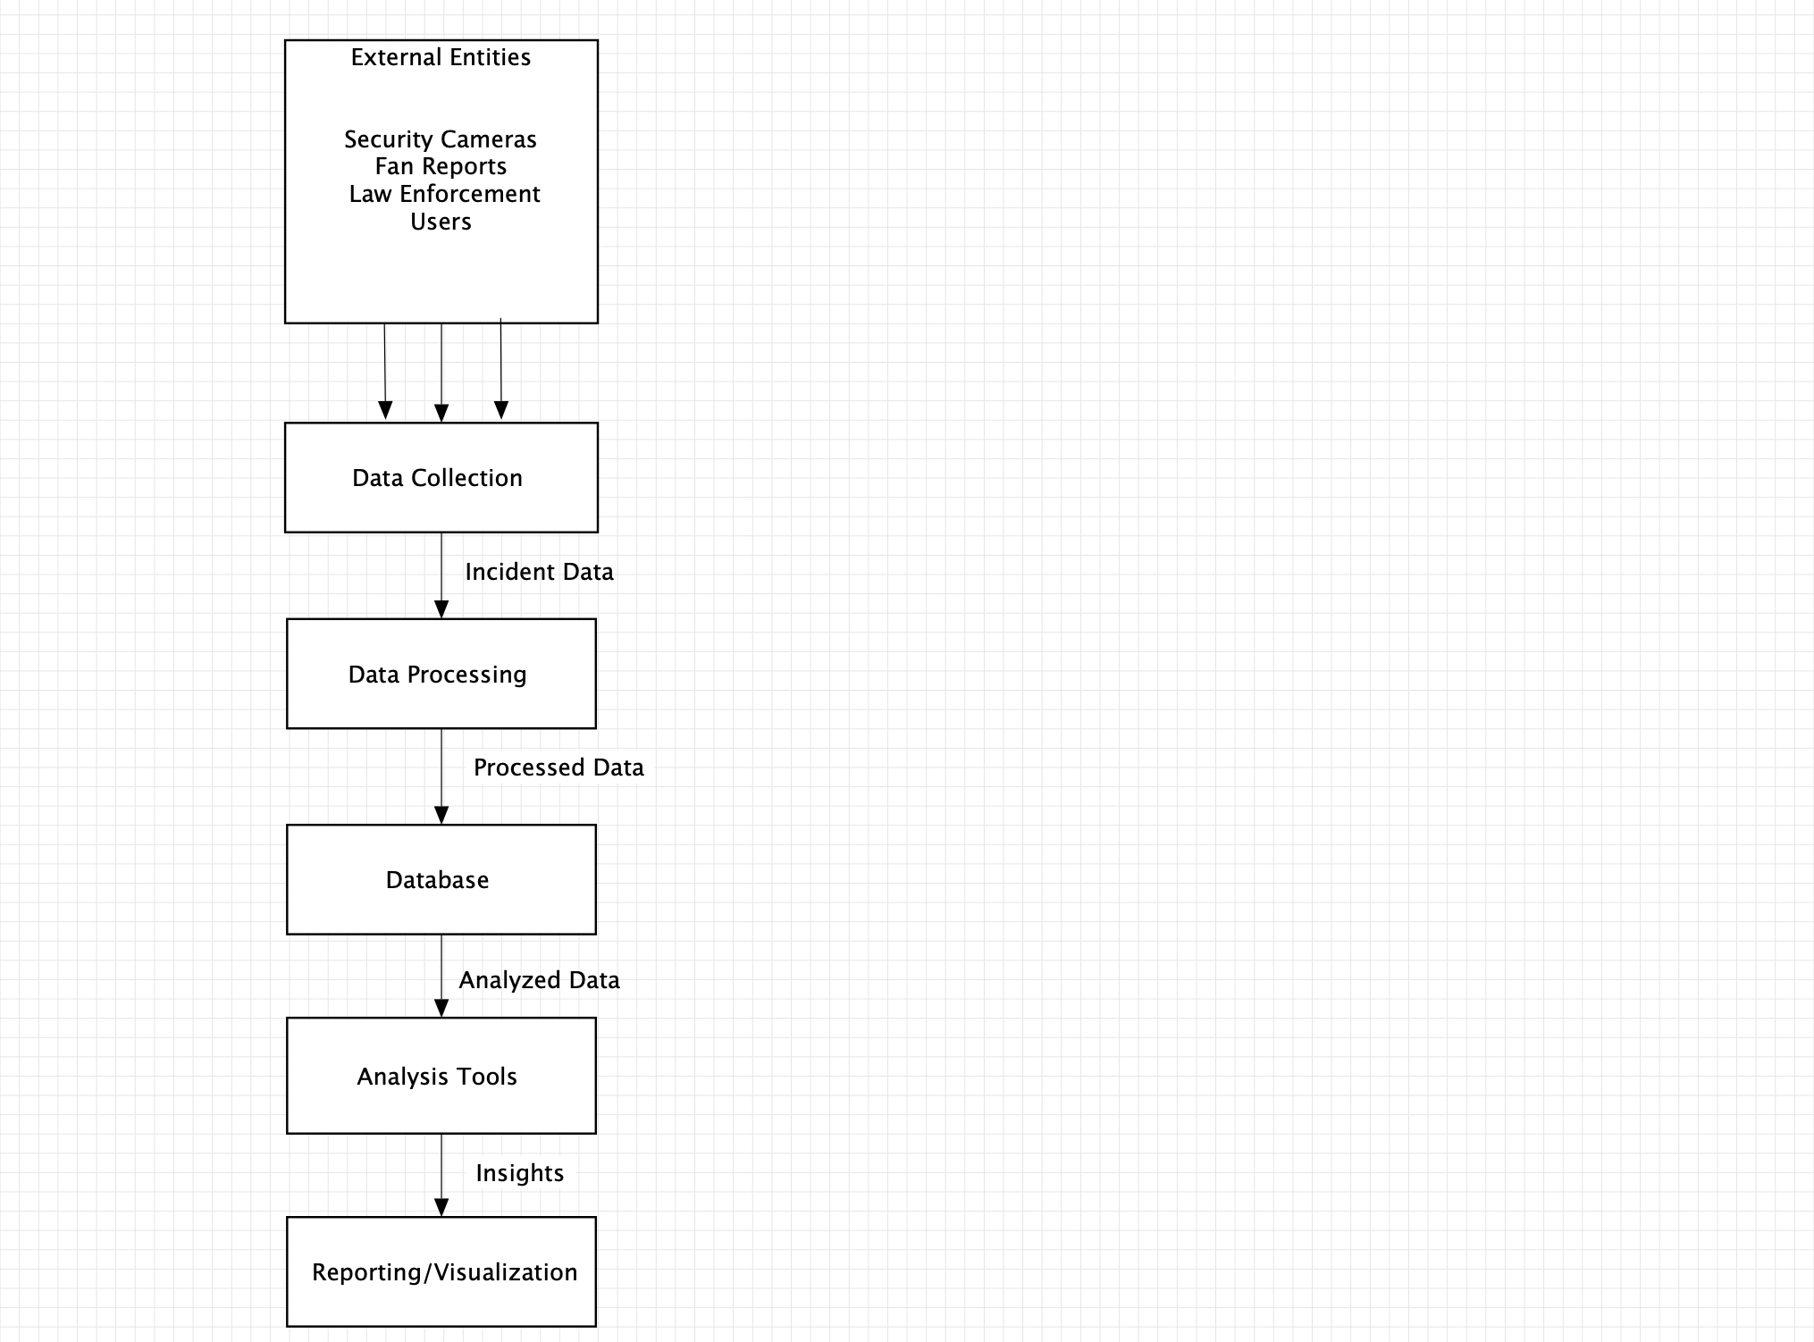
Data-Flow-Diagram

Slide 11
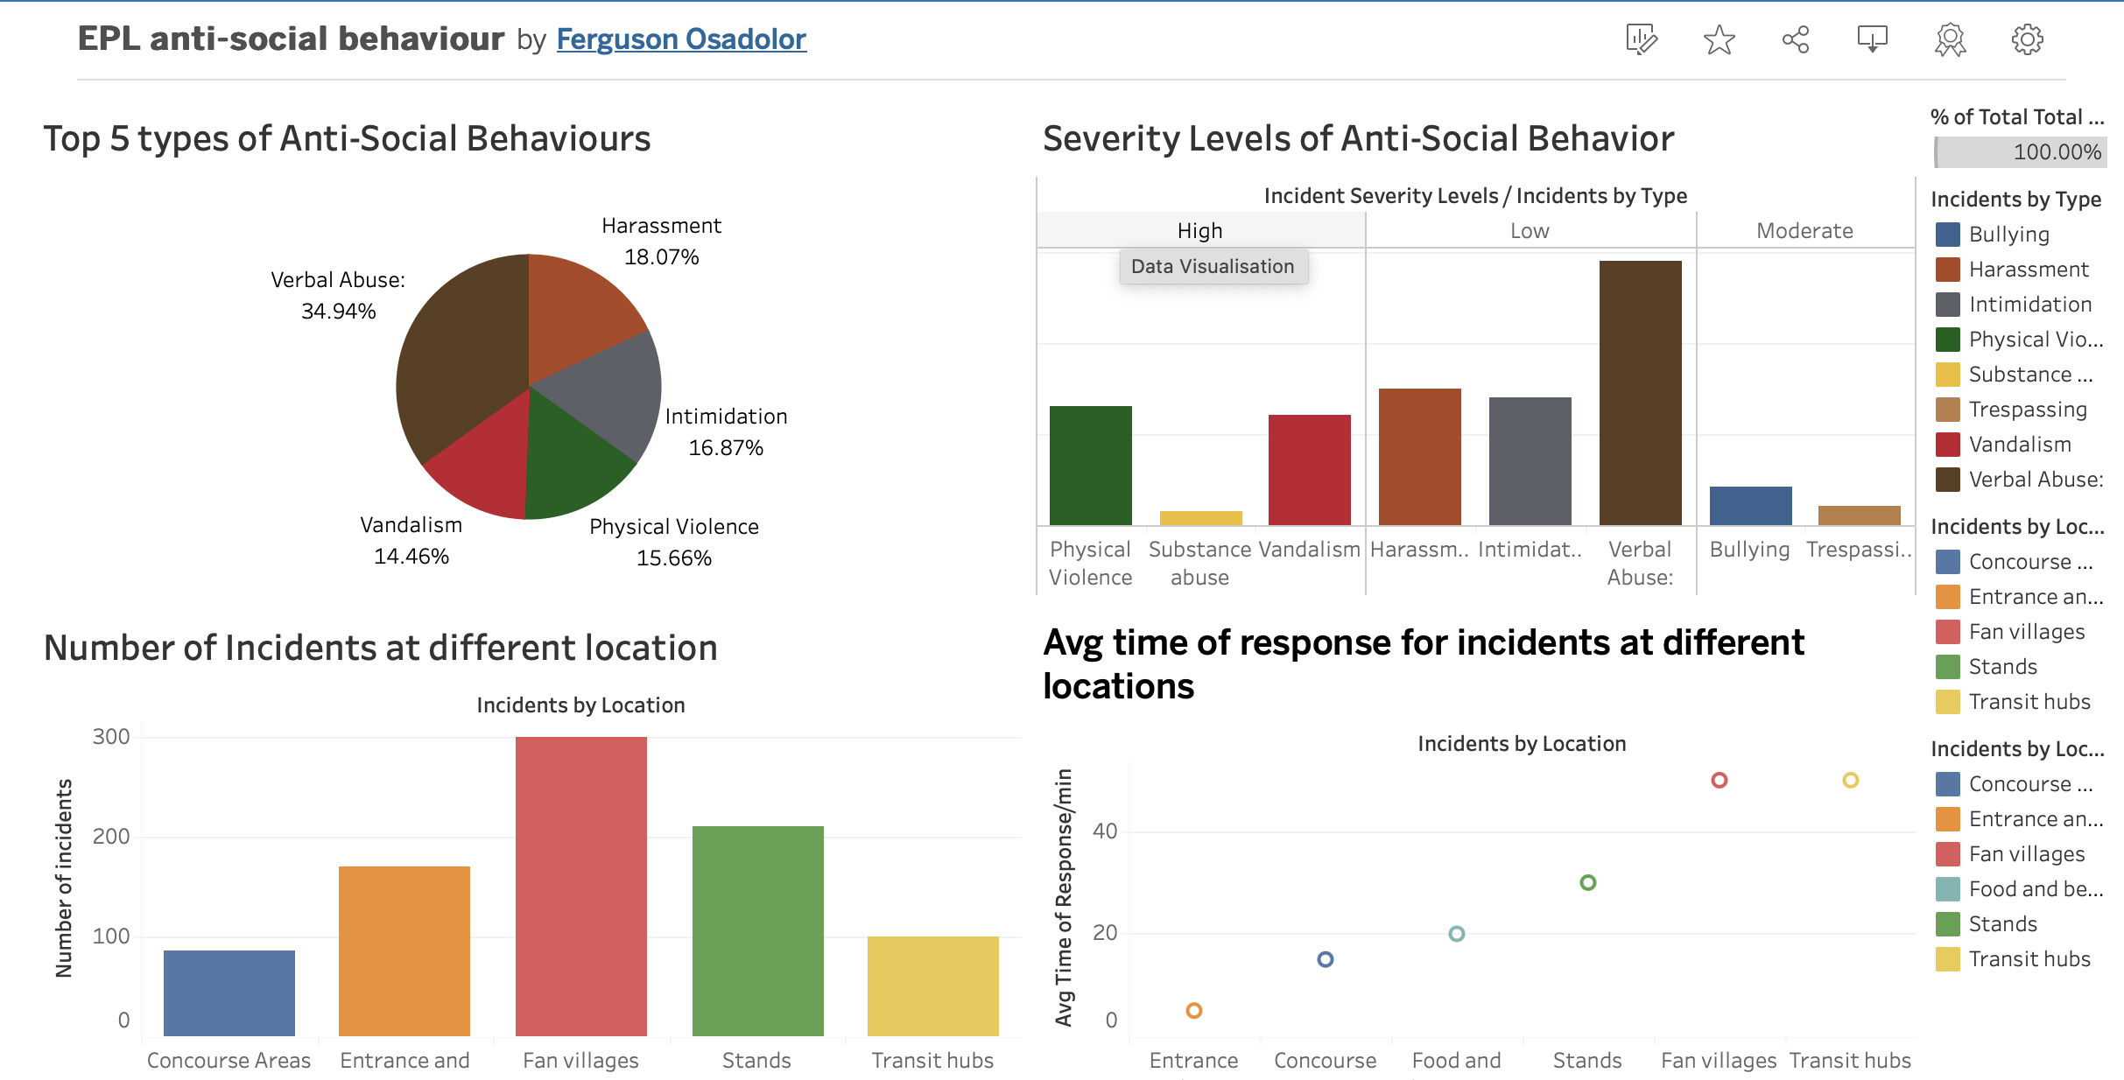
Analytics and Reporting

Slide 12

Summary

Slide 13

Thank you!
ANY QUESTIONS?

